Slide 1

Coating Team Data Collection and Reporting Apps
Raytheon Company
13510 N. Central Expressway http://www.raytheon.com/
Sabrina Watson
Sabrina.Ratliff@raytheon.com
Miguel A. RAZO-RAZO

Slide 2



Coating Team Data Collection and Reporting Apps Raytheon Company
Company Overview:
Raytheon Company is a technology and innovation leader specializing in defense, security and civil markets throughout the world. With a history of innovation spanning 92 years, Raytheon provides state-of-the-art electronics, mission systems integration, and other capabilities in areas of:
Sensing
Effects
Command, Control, Communications and Intelligence systems
Broad range of mission support services
Next Generation Jammer
AN/TPY-2 Radar
JLENS Aerostat

Slide 3
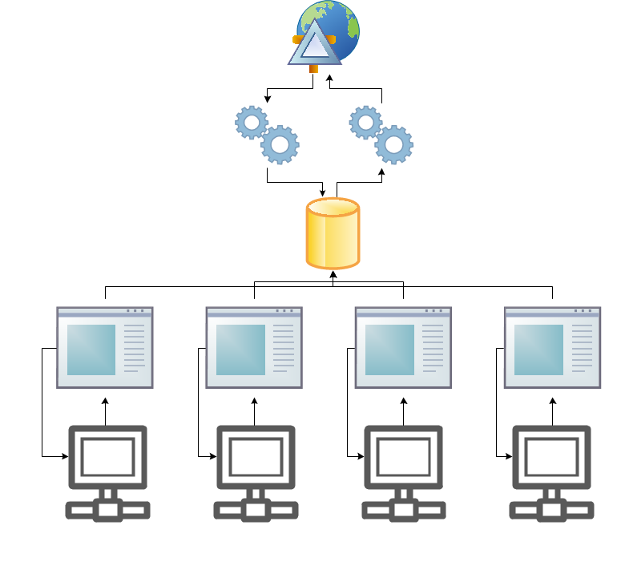
Coating Team Data Collection and Reporting Apps Raytheon Company
Insert company logo here
Project Background:
Process Engineering Teams under the Mixed Signal Packaging and Process Design Department require several web applications to maintain and evaluate equipment/process data and perform remediation when necessary. Currently, one process team has a data collection and reporting system that is not efficient or sustainable.
Presentation Tier
Logic Tier
Data Tier
Data Collect 1
Data Collect 2
Data Collect 3
Data Collect 4
Machine 1
Machine 2
Machine 3
Machine 4
Data Collection and Reporting System

Slide 4
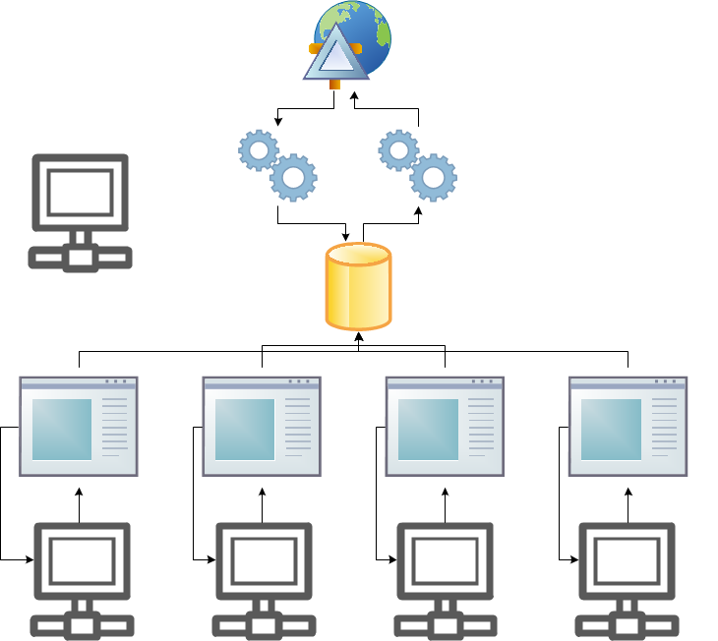
Coating Team Data Collection and Reporting Apps Raytheon Company
Project Objectives:
Create scalable architecture and reduce maintenance time for future features and enhancements of the data collection and reporting system.
Software structure requires collection and storage of data, straightforward reporting and feedback of nonconforming data.
If time permits, an application for operation certification tests will be created.
Presentation Tier
New Equipment?
Logic Tier
Data Tier
Data Collect 1
Data Collect 2
Data Collect 3
Data Collect 4
Machine 1
Machine 2
Machine 3
Machine 4
Data Collection and Reporting System

Slide 5
Coating Team Data Collection and Reporting Apps Raytheon Company
Insert company logo here
Skill Sets
EXPERIENCE | VERSION
REQUIRED
Visual Studio, C#, VB, ASP.NET | VS 2012, 4.0
SQL Server | 2005/2008/2012
Javascript, AJAX, HTML, CSS
Internet Information Services (IIS) | 6.1
DESIRED
SSO, XML and variants
Web Services Security
Entity Framework | 4.0+

Slide 6
Coating Team Data Collection and Reporting Apps Raytheon Company
Insert company logo here
Logistics
Students must be US Citizens and willing to sign an NDA (Non-Disclosure Agreement)
Mentor(s) and Students will meet weekly to bi-weekly both at UTD and Raytheon

Slide 7
Software Engineering Project Phases
SRS
SPD
SDD
Implementation Test Development
Integration Test Refinement
ATP
Software Requirements Spec
Software Preliminary Design
Software Detailed Design
Acceptance Test Precedure

Slide 8
Collection Requirements
Configurable, scalable, tiered
The collection system shall collect data from process runs. The data sources shall be:
Files, User input, Network messaging (optional)
Data will be columnar, csv, tsv, xml, or space delimited
The collection tier shall collect data of different types
Integer, floating point, fixed point, fixed point, text
Data “units” shall be configurable
Examples: micrometer, millimeter, inches, centimeter, pounds, pressure, degrees C, degrees F, volts, amps, Hz, reflectivity, candle power, hardness, viscosity, etc.
Scalars (ex: mm, volts, amps), Areas (mm2), Volumes (mm3)
The collection system shall relate process run codes, lot codes, and product manufacturer serial numbers (MSNs)
MSNs belong to lots. Lot sizes vary.
User shall be able to input MSNs for a lot directly or via bulk loaded via spreadsheet, barcode scanned, imported via external database connection
The system shall be able to handle linking runs which contain MSNs from more than one lot
User entered, bulk loaded via spreadsheet, barcode scanned
The collection tier shall handle processes of one or more steps
Data will be collected at 1 or more points and tied to process runs, lots, and MSNs
A process shall have 1 or more machine that performs the process. Machines have calibration dates, certifications, etc. Machines used for a given process shall be associated to MSNs.
Data collection points shall collect 0 to many process materials
Substances identification, Quantity, Manufacture’s lot code

Slide 9
Reporting Requirements
TBD

Slide 10
Naming conventions
Code (C#)
Tables
Fields, PK, FK
Stored Procedures

Slide 11
Coding conventions
Your coding conventions may affect the scalability and configurability of your design.
Others ideas.
private func(){
…
…
}
private func()
{
…
…
}
Preferred. Same for if/else and for/while/do/until
private func( int x, int y, int z…
private func( int x,
int y,
int z…
Preferred when line would exceed 80 columns otherwise inline is ok.
private func( int i )
{
int x;
int y;
if( x > 0 )
{
y = x + 3;
}
}
3 char indent. Set the IDE to use spaces instead of tabs and set auto indention to 3 spaces.

